Slide 1

Cooking Daddy
Sierra Nicholes
Andrew Taylor
Joshua Stallard
Ryan Marinoff

Slide 2
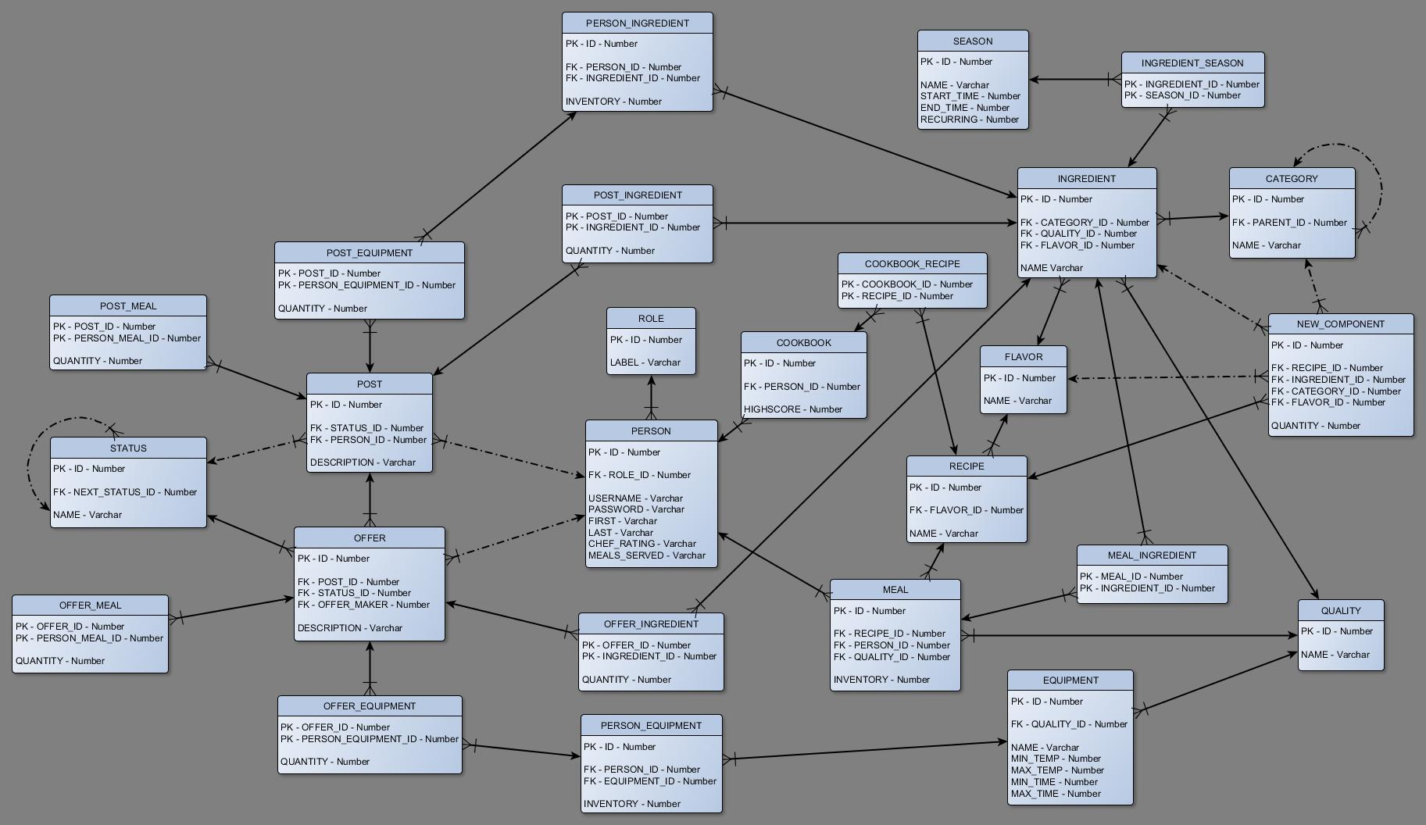
Database

Slide 3



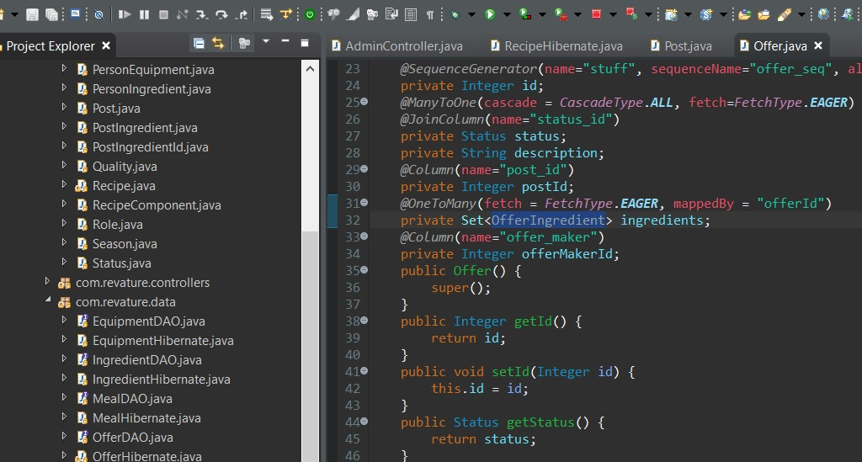
Administrator
View, Add, and Remove
Recipes
Ingredients
Categories
Flavors
Seasons
Qualities

Slide 4
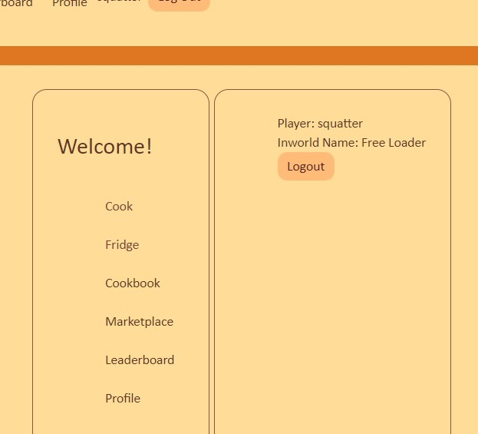


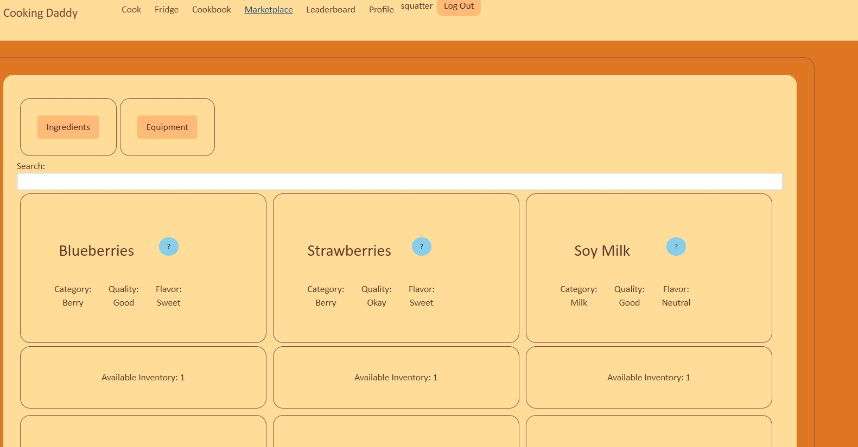
Game Play
Register as new Player
Cooking
Fridge Contents
Cookbook (TBA)
Market Place
Leaderboard (TBA)
Profile (TBA)

Slide 5
Burndown Chart

